Slide 1
Natural Language Processing: Classifying Reddit Posts
r/GainIt and r/LoseIt
Albin Wan

Slide 2
Content
Introduction
Web Scraping
EDA
Modelling
Conclusion

Slide 3
Introduction
r/GainIt
Fitness subreddit for information and discussion for people looking to put on weight, muscle, and strength.
r/LoseIt
A place for people of all sizes to discuss healthy and sustainable methods of weight loss. Whether you need to lose 2 lbs or 400 lbs, you are welcome here!

Slide 4
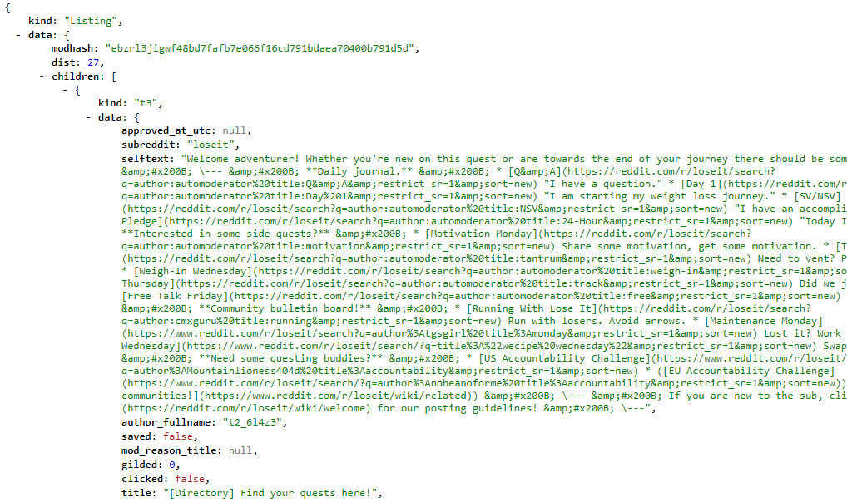
Reddit Scraping

Slide 5
Total of 1441 posts scraped
7709 vectorized for r/GainIt 9574 vectorized for r/LoseIt

Slide 6
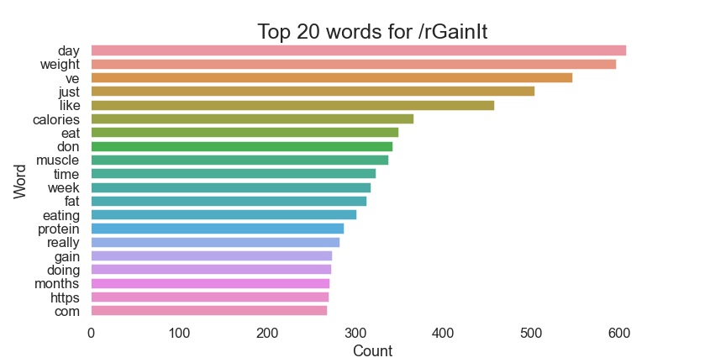
EDA
What comes to mind when you think about ‘weight gain’?

Slide 7
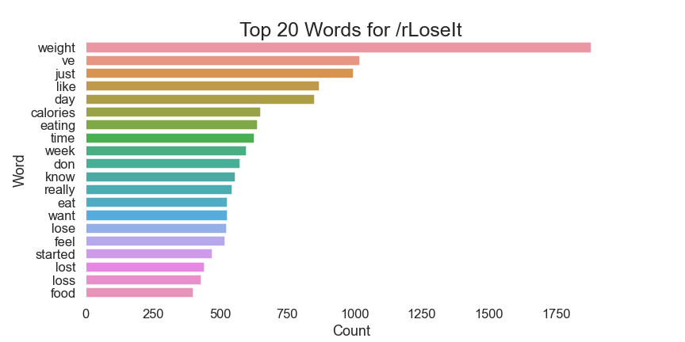
EDA
What about ‘weight loss’?

Slide 8
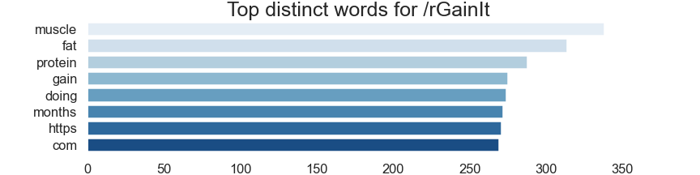
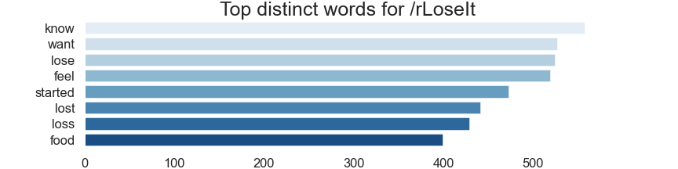
EDA
Remove overlapping words to identify distinct top words

Slide 9
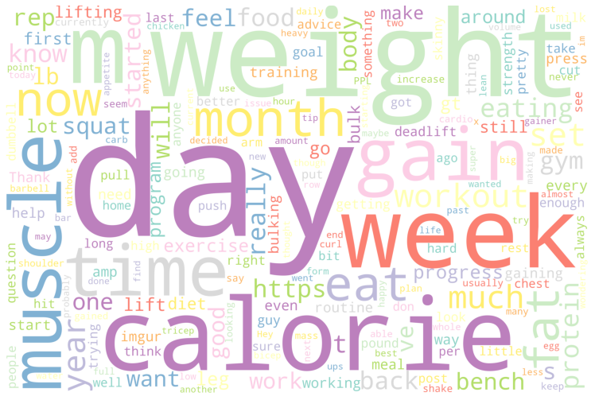
EDA
r/GainIt

Slide 10
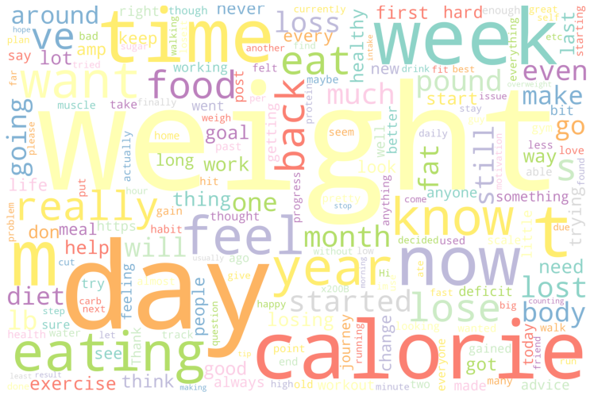
EDA
r/LoseIt

Slide 11
EDA
Which is which?

Slide 12
Modelling
Model 1
Count Vectorizer Logistic Regression
Model 3
TF-IDF Vectorizer Multinomial NB
Model 2 TF-IDF Vectorizer Logistic Regression
Model 4
TF-IDF Vectorizer Random Forest

Slide 13
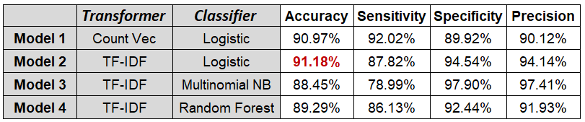
Modelling
Summary of model scores

Slide 14
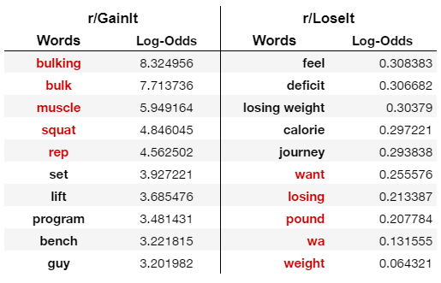
Modelling
Coefficients

Slide 15
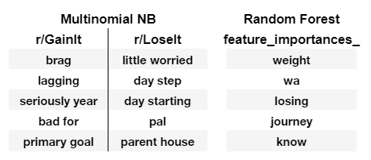
Modelling
Other models

Slide 16
Conclusion
TF-IDF the better vectorizer
Logistic Regression the better classifier
Use earlier keywords to better fit post into subreddit
Model worked well even though EDA revealed some concerns regarding similarities between the two subreddits

